Slide 1




Introduction to Visualizing Car Data
Visualizing car data can unlock powerful insights about vehicle performance, trends, and consumer preferences. By analyzing data through intuitive charts and graphs, businesses and enthusiasts can make informed decisions, identify opportunities, and uncover hidden patterns in the world of automobiles.
by gowtham eshwar

Slide 2

Data Cleaning: Removing Unwanted Records
1
Identify Irrelevant Data
2
Handle Missing Values
Examine the dataset and determine which records are not needed for the analysis, such as test or incomplete entries.
Replace or remove any missing data points to ensure the dataset is complete and accurate.
3
Eliminate Duplicates
Identify and remove any duplicate records to avoid skewing the analysis.

Slide 3
Data Filtering: Selecting Relevant Attributes
Feature Selection
Categorical Data
Numerical Data
Determine the most important car attributes to focus the analysis, such as make, model, year, and performance specs.
Identify and segregate categorical variables like brand, color, and transmission type for more meaningful visualizations.
Extract numerical attributes like horsepower, fuel efficiency, and price to uncover quantitative trends.

Slide 4
Counting and Summarizing Data
Total Vehicles
Average Attributes
Calculate the overall count of cars in the dataset to establish the scale of the analysis.
Determine the mean, median, and other statistical measures for numeric car features.
Frequency Distributions
Insights at a Glance
Analyze the number of cars in each category, such as by make, model, or color.
Quickly summarize the key characteristics of the car dataset through concise metrics and visualizations.

Slide 5
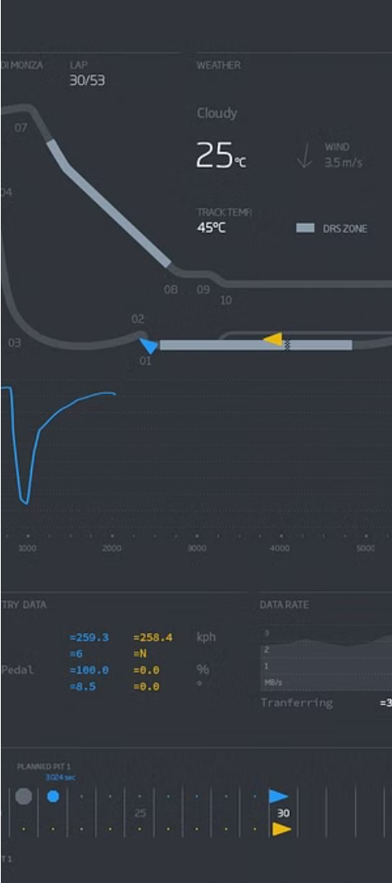
Visualizing Numerical Attributes
1
Histograms
Plot the distribution of numerical car features like horsepower or fuel efficiency to identify patterns and outliers.
2
Scatter Plots
Visualize the relationship between two numeric attributes, such as price and mileage, to uncover correlations.
3
Line Charts
Track the changes in car specifications over time, like average MPG by model year, to spot trends.

Slide 6
Visualizing Categorical Attributes
Bar Charts
Pie Charts
Treemaps
Visualize the frequency or count of cars by categorical variables like make, model, or color to identify popular options.
Represent the proportional breakdown of car categories, such as by transmission type or fuel source, to see market share.
Display hierarchical data, like car models within each brand, to understand product lineups and sales volumes.

Slide 7
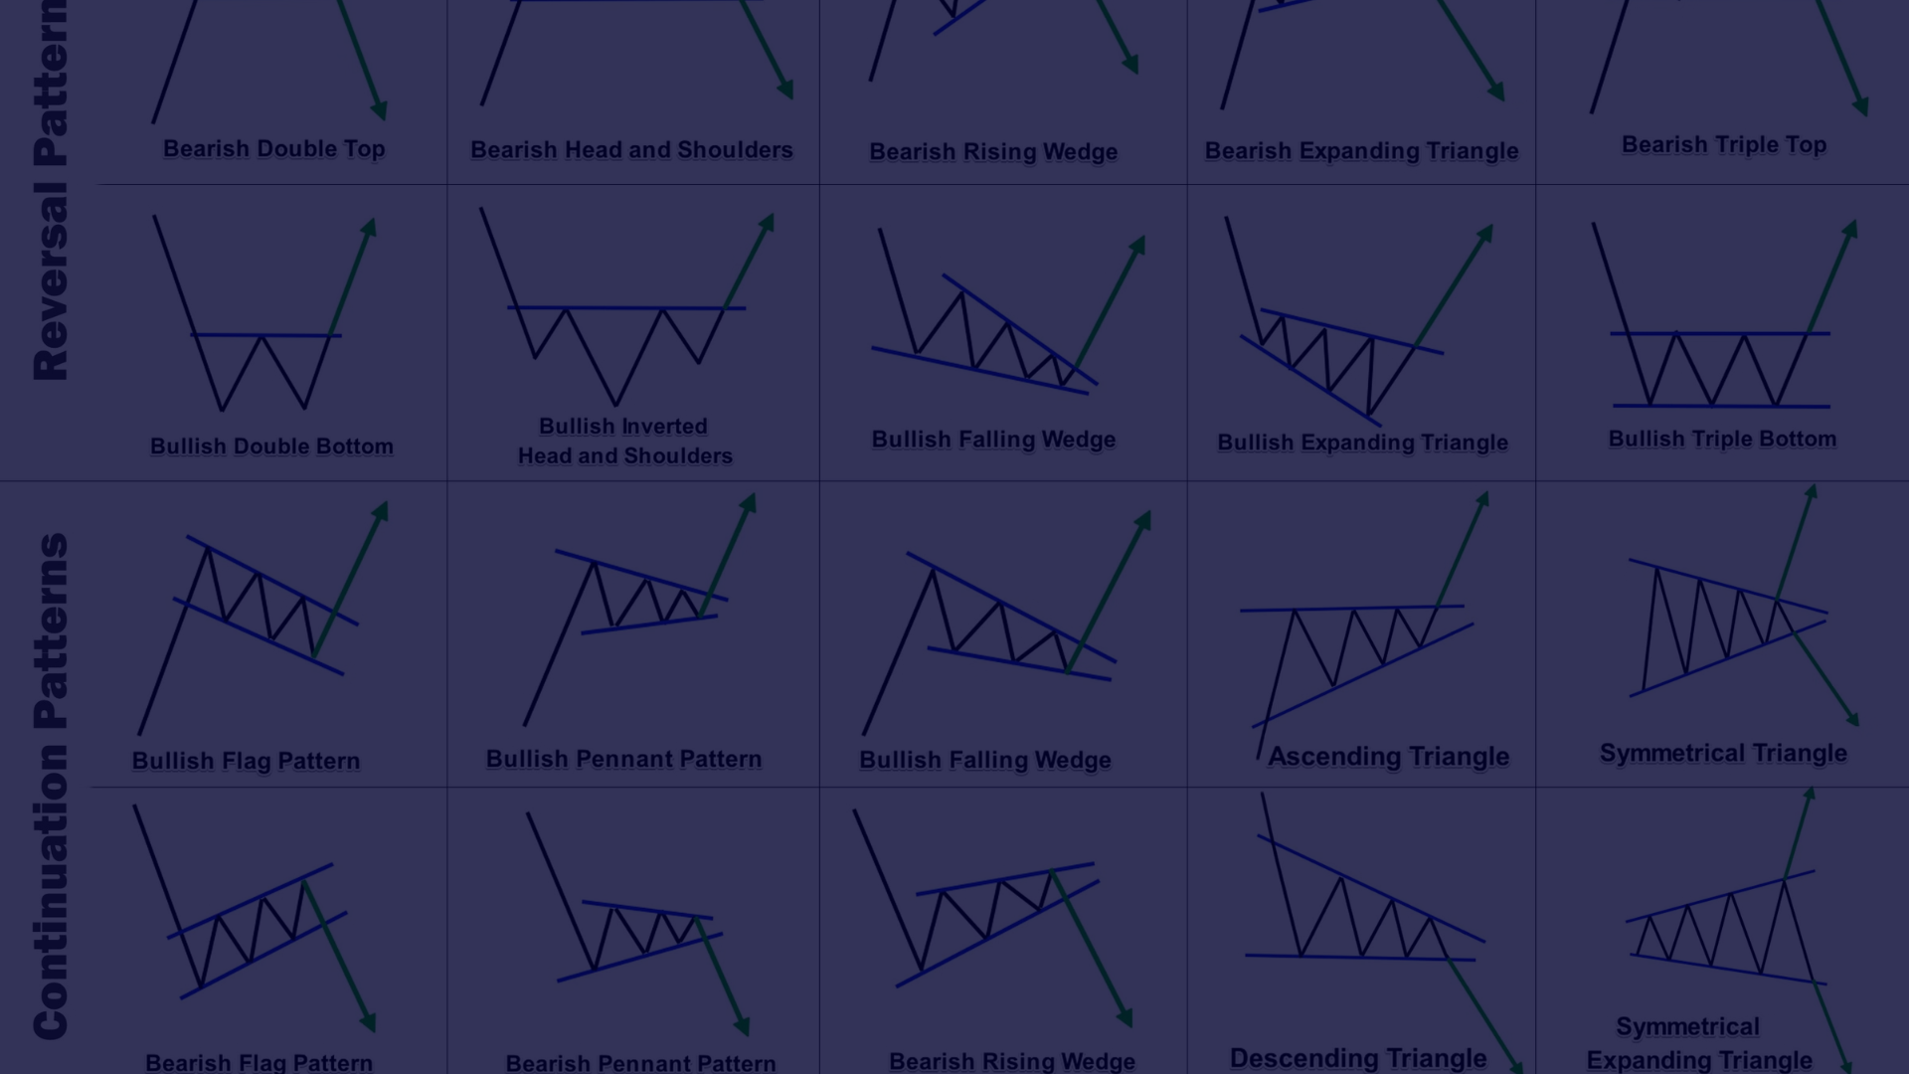



Identifying Patterns and Trends
Correlations
Clusters
Anomalies
Analyze how car features are related to each other, such as the link between horsepower and price.
Group similar cars together based on their attributes to uncover market segmentation and consumer preferences.
Detect outliers or unusual data points that may represent unique cars or data quality issues.

Slide 8



Conclusion and Key Takeaways
Powerful Insights
Identify Trends
Reveal Opportunities
Car data visualization unlocks a wealth of insights to drive strategic decisions and innovations.
Uncover emerging patterns and shifts in the automotive market to stay ahead of the competition.
Spot untapped market segments and identify areas for product development and improvement.

Slide 9
Done by
S Dhanush
Atchut Varma
B Gowtham

